Slide 1
Review question 1: ER modelling
The City of Melbourne is developing a database system to store details of the trees within the municipality. The City’s existing system records the year each tree was planted and the tree’s diameter at breast height (DBH). The DBH value is updated every year, and the date of the most recent update is stored alongside the value itself. The latitude and longitude of the tree are also tracked.
For trees that are planted after the system is implemented, the City arborist who oversaw the planting of the tree is recorded, along with the day and month they planted the tree, their notes about site conditions, and the soil water content reading taken on the day of planting.
The species of each tree needs to be stored. Each species has a common name as well as a botanical genus and species; it may be native or introduced, and it may be evergreen or deciduous.
The City manages various parks, each of which has a name and street address, and which is managed by a City arborist. The park in which each tree is located must be recorded – although some trees, such as street trees, are not situated in a park.
City arborists are known by a name and employee number.
Develop a conceptual ER model for this case study. You may use either Chen’s or crow’s-foot notation, but do not mix the two.

Slide 2

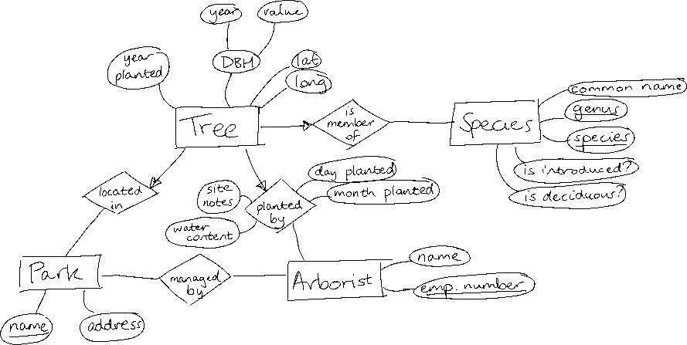



Slide 3
NOTE FOR TUTORS: The SQL review questions on the following slide cannot all be completed in the allotted time. Select a few to complete (maybe q3 as a gentle refresher, then one of q4 or q5). Use q1 and q2 simply as a way to remind them to revise CREATE TABLE statements and RA, as they haven’t been assessed on that yet.

Slide 4
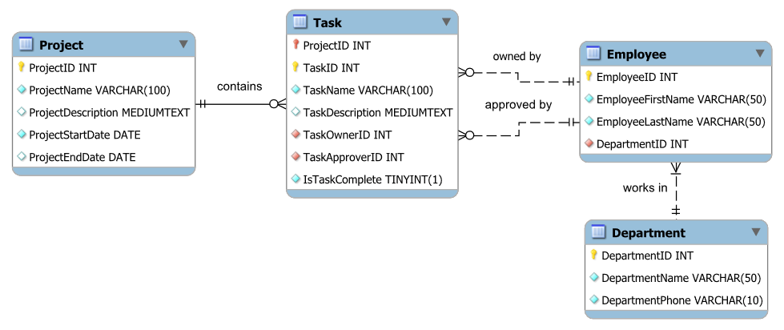
Review question 2: Relational algebra and SQL
The following is part of a schema for a company’s project management system.
Write a MySQL DDL statement that creates the Task table. Assume that the other three tables already exist.
Write a relational algebra expression that finds the name and description of tasks owned by employees whose last name is Williams.
Write an SQL query that fetches the ID, first name and last name of employees in the Costumes department.
Write an SQL query that finds the name of each department, the number of employees in that department who own at least one task, and the total number of tasks owned by those employees.
Write an SQL query to find the number of incomplete tasks approved by an employee from the Costumes department which belong to a project that started before May 2010.
Notes:
5.
SELECT user_name FROM user WHERE user_name NOT IN (SELECT ipb_by_text FROM ipblocks WHERE ipb_user = user_id AND ipb_by_text = user_name) AND user_name NOT IN (SELECT ipb_by_text FROM ipblocks INNER JOIN user_groups ON ipb_user = ug_user WHERE ug_group = 'bot')
Or could rewrite using NOT EXISTS

Slide 5
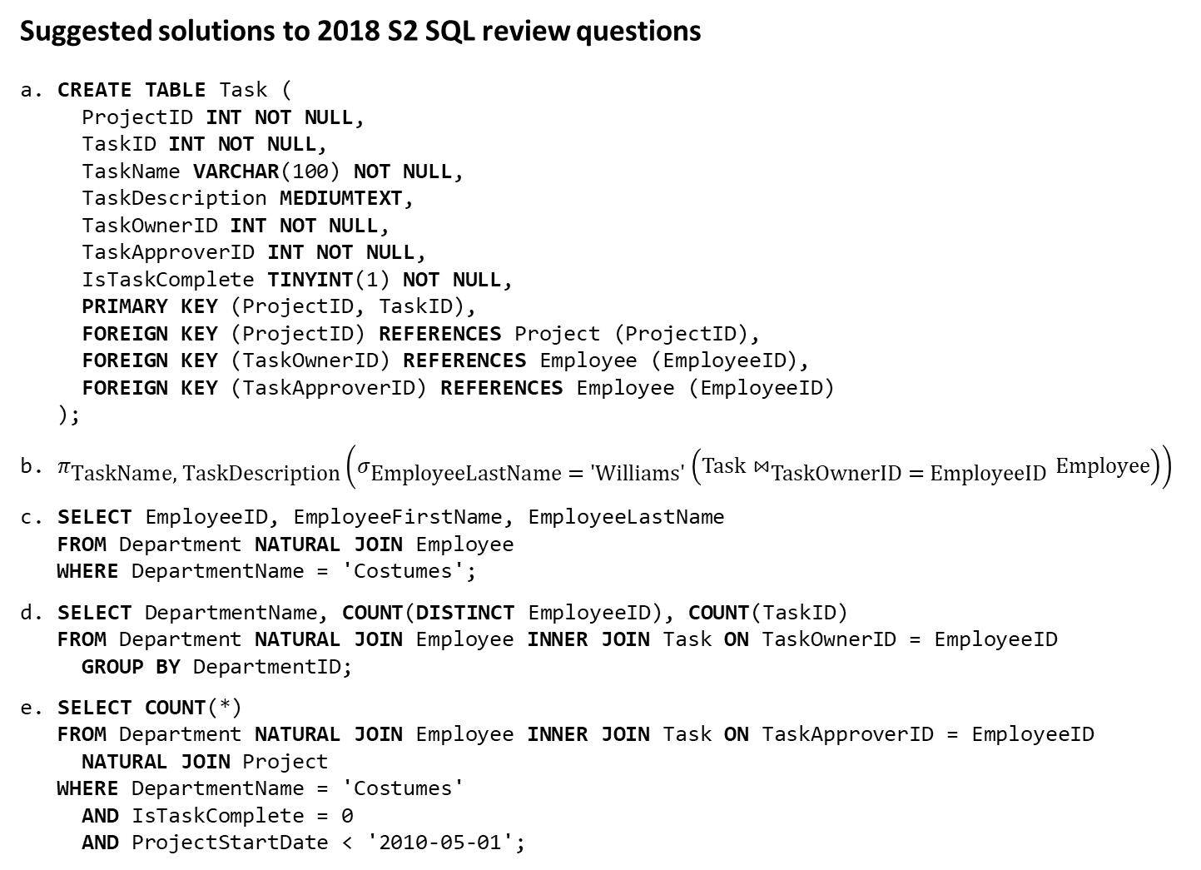
Suggested solutions to 2018 S2 SQL review questions
CREATE TABLE Task ( ProjectID INT NOT NULL, TaskID INT NOT NULL, TaskName VARCHAR(100) NOT NULL, TaskDescription MEDIUMTEXT, TaskOwnerID INT NOT NULL, TaskApproverID INT NOT NULL, IsTaskComplete TINYINT(1) NOT NULL, PRIMARY KEY (ProjectID, TaskID), FOREIGN KEY (ProjectID) REFERENCES Project (ProjectID), FOREIGN KEY (TaskOwnerID) REFERENCES Employee (EmployeeID), FOREIGN KEY (TaskApproverID) REFERENCES Employee (EmployeeID) );
$π_{\text{TaskName}\text{, }\text{TaskDescription}}\left(σ_{\text{EmployeeLastName}\text{ = ′}\text{Williams}\text{′}}\left(\text{Task}⋈_{\text{TaskOwnerID}\text{ = }\text{EmployeeID}}\text{Employee}\right)\right)$
SELECT EmployeeID, EmployeeFirstName, EmployeeLastName FROM Department NATURAL JOIN Employee WHERE DepartmentName = 'Costumes';
SELECT DepartmentName, COUNT(DISTINCT EmployeeID), COUNT(TaskID) FROM Department NATURAL JOIN Employee INNER JOIN Task ON TaskOwnerID = EmployeeID GROUP BY DepartmentID;
SELECT COUNT(*) FROM Department NATURAL JOIN Employee INNER JOIN Task ON TaskApproverID = EmployeeID NATURAL JOIN Project WHERE DepartmentName = 'Costumes' AND IsTaskComplete = 0 AND ProjectStartDate < '2010-05-01';

Slide 6
Review question 3: Theory topics (tutorials 1-5, weeks 2-6)
Describe the three stages of database design using dot points.
Define the terms “multivalued attribute” and “key constraint”, giving examples of each.
A subtype relationship may be total or partial. Explain the difference. Illustrate your answer with a diagram in either Chen’s or crow’s-foot notation. (topic no longer taught)
Give the names and symbols of the seven operators of relational algebra, excluding the “rename” operator. Write three relational algebra expressions that return (effectively) the same result set to illustrate the parallels between the three operators that combine data from differently-structured tables.
The following relations exist: orderitem (orderid, itemid, quantity) item (itemid, itemdesc, itemonsale) Rewrite the following query using the IN operator: SELECT SUM(quantity) FROM orderitem NATURAL JOIN item WHERE itemonsale = 1;
State two similarities and two differences between clustered and unclustered indexes. In a table that is part of a relational database, on which column(s) is/are a clustered index most likely to be created?

Slide 7
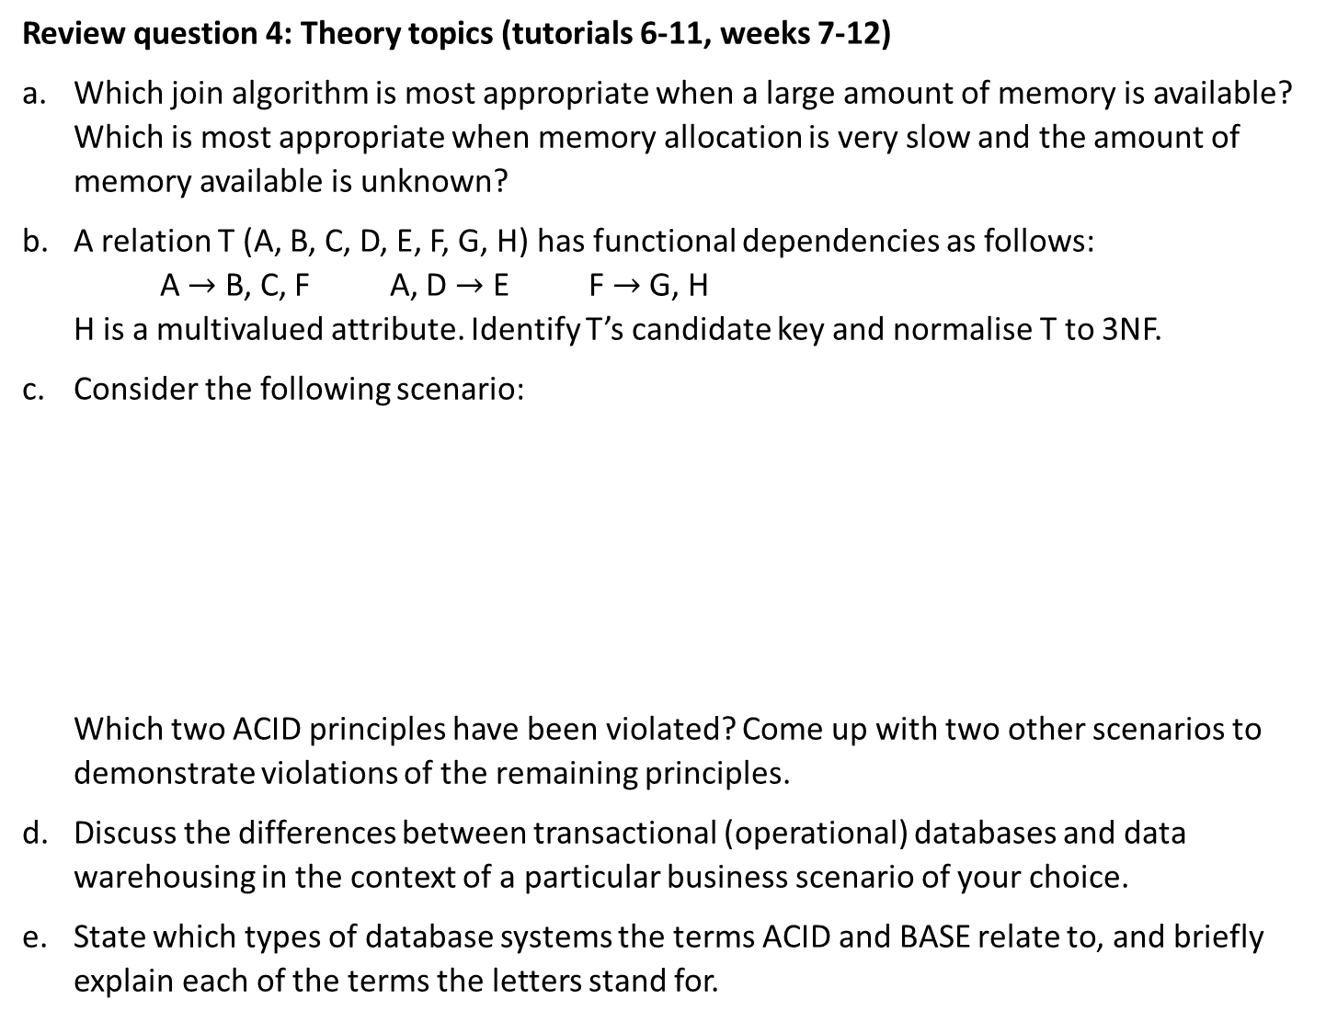
Review question 4: Theory topics (tutorials 6-11, weeks 7-12)
Which join algorithm is most appropriate when a large amount of memory is available? Which is most appropriate when memory allocation is very slow and the amount of memory available is unknown?
A relation T (A, B, C, D, E, F, G, H) has functional dependencies as follows: A $→$ B, C, F A, D $→$ E F $→$ G, H H is a multivalued attribute. Identify T’s candidate key and normalise T to 3NF.
Consider the following scenario:
Which two ACID principles have been violated? Come up with two other scenarios to demonstrate violations of the remaining principles.
Discuss the differences between transactional (operational) databases and data warehousing in the context of a particular business scenario of your choice.
State which types of database systems the terms ACID and BASE relate to, and briefly explain each of the terms the letters stand for.
Hayley left Bowen Industries a month ago. Her data was removed from the Employee, EmployeeWorkHistory and EmployeeProject tables, but rows relating to her are still present in the EmployeePayroll and EmployeeBenefits tables. The DBA has established that the database server was shut down for an offline backup in the middle of deleting Hayley’s data.

